Slide 1
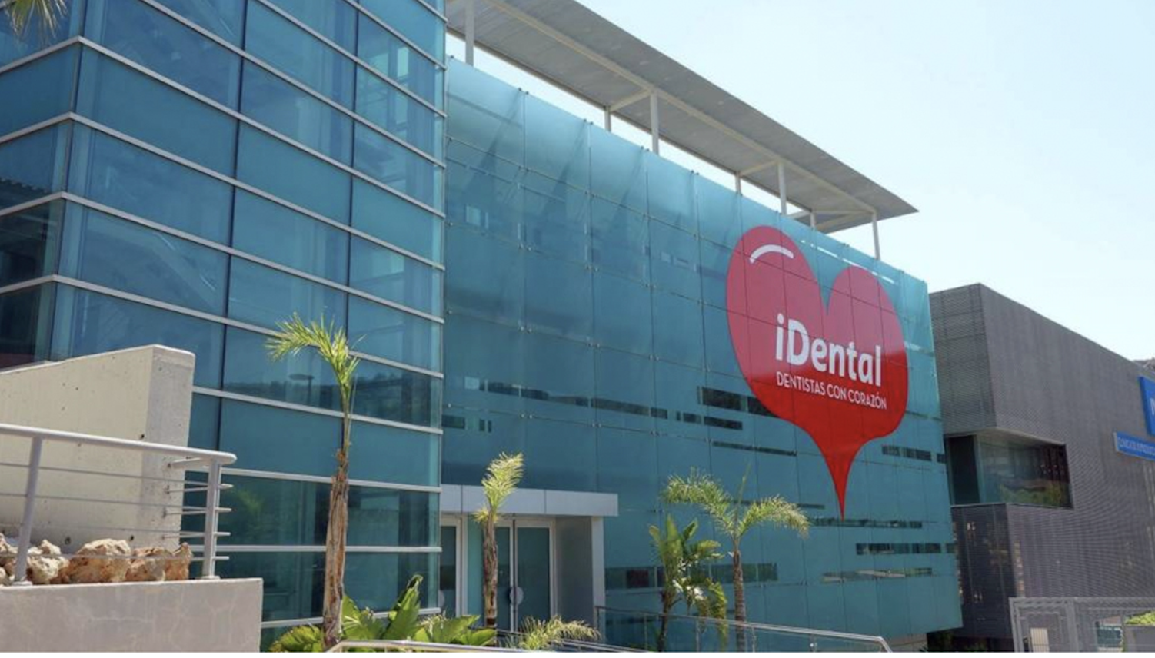


iDental, Dentists with a heart
The Great Dental Scandal
Dr. Miguel Ángel López-Andrade Jurado
Delegate for international affairs
General meeting november 2018

Slide 2
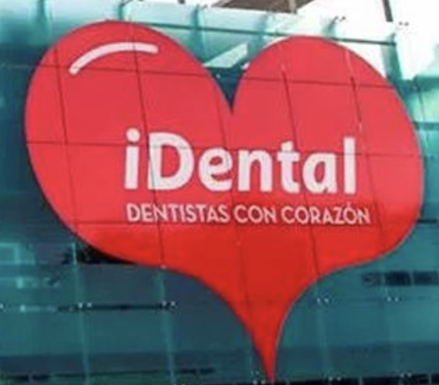
Summary
01
IDental
02
The context of the problem
03
Closure of Idental clinics
04
Procedure before the Courts
05
Actions by the Organisation of Colleges
0
06
Possible solutions

Slide 3
1
iDental
iDental history
2014 → Creation of the commercial company Idental, formed by a large number of companies, being the main ones:
                DENTAL GLOBAL MANAGEMENT S.L.
                GLOBAL CLINIC S.L.
                IFACTORY GLOBAL LAB S.L.
                UCS GLOBAL TRAINNING S.L.
                SISTHEX IBERIA S.L.
                RANDOM CORPS S.L.
October 2017 → sold to the investment fund WESTON HILL (↑ €25,000,000)
2018 → bankruptcy iDental → closure of all clinics

Slide 4
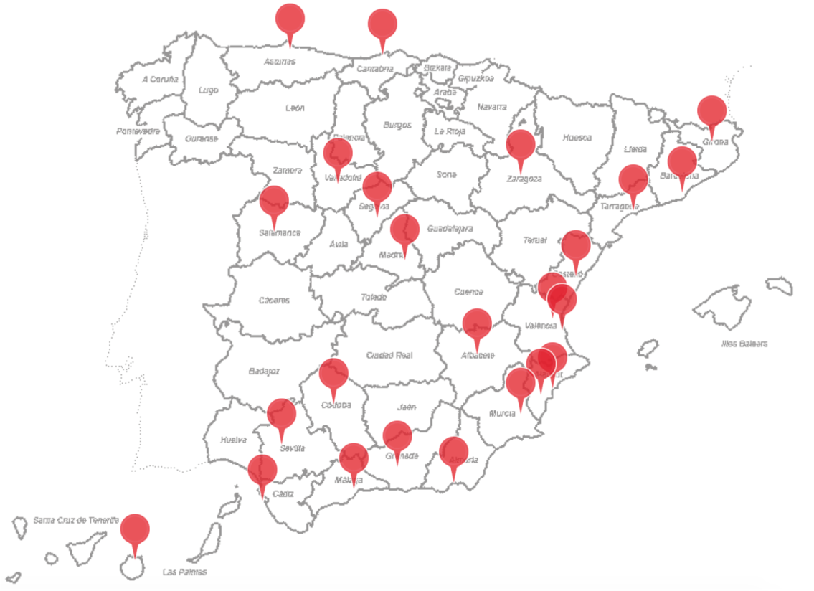
01
iDental
iDental’s Structure
24 clinics in Spain
Business model → "low cost" clinics
Macro-clinics → 100.000 m²
3,171 employees (800 of whom are dentists)
More than 350,000 patients treated
Cheap specialist labour (paid postgraduate training)
Bimonthly and late payments to workers
Sometimes → working hours exceed 12 hrs./day, sick leave due to anxiety and injuries...

Slide 5
1
iDental
Customer acquisition mechanism
Numerous advertisements in social networks and media
Promises that are difficult to fulfil:
    Social dental care: private dental aids
    Dental aids: rate of aid applied to the budget
    Compulsory financing schemes
    Rapid growth: expansion without the ability to cope with contracted treatments
    Aggressive mass advertising: confused perception of reality and supposed "social service" through collaborations with companies and NGOs
    Techniques "all on four"

Slide 6








02
The context of the problem
THE PROFESSIONAL
PLETHORA
7
7 – LAX AND POORLY ENFORCED LEGISLATION
1 – PROFESSIONAL PLETHORA
LACK OF
PUBLIC
COMMITMENT
TO DENTAL
CARE IN SPAIN
LAX AND POORLY
APPLIED
LEGISLATION
2 – POOR PUBLIC TREATMENT COVERAGE
The Spanish Dental Bubble
3
6
6 – DENTURISM AND INTRUSION
MISLEADING
HEALTH
ADVERTISING
3 – LOW CARE DEMAND
5 – NEW MODELS OF DENTAL CLINICS
5
4 – FINANCIAL CRISIS
NEW TYPES
OF
DENTAL
CLINICS

Slide 7
02
The context of the problem
HUMAN RESSOURCES
(DENTISTS)
PERMISSIVE AND LAX LEGISLATION
TARGET
PATIENTS
22 dental schools (12 state and 10 private
1750 new dentists every year
Absence of effective clausus numbers
Lack of resource health planning
Spain is one of the EU countries with the lowest demand for dental care
Massive emigration, underemployment and dental unemployment
Limited legislation, poorly enforced and not dissuasive to offenders
Lack of unity of criteria at national level
Regional legislation
Professional societies law infringed
Health advertising law not respected
Lack of political sensitivity
Disadvantaged social sector
Poor educational level
Scams on alleged subsidies
Financing of treatments
Context of economic crisis
No public involvement in dental care
Aggressive and misleading advertising

Slide 8

3
Closure of IDental clinics
Consequences of closure
1
2
3
4
High number of people affected (↑ 200,000)
Unfinished treatments
Difficulties in stopping the payment of cosumer credits
Need of expert reports
5
6
7
8
Lack of custody of medical records
Offers from other franchises
Blame game
Dismissal of 3,500 workers and creditors without payment

Slide 9
4
05
Procedimientos Judiciales
Qué hemos hecho?
Court of Instruction No. 5 of the National High Court .
Investigation phase against iDental (corporate group) and its administrators.
Presumed crimes: - Pyramid Scam
- Misappropriation
- Crimes against public health
- Injuries
Adoption of precautionary measures: detention of administrators and judicial intervention of companies (Deloitte judicial administrator).
2. Judicial declaration of bankruptcy of creditors.
3. Sanctioning procedures of the State Administration, Ministries of Consumption and Health → sanctions against iDental (almost 2 million euros).
DIPUTADOS

Slide 10
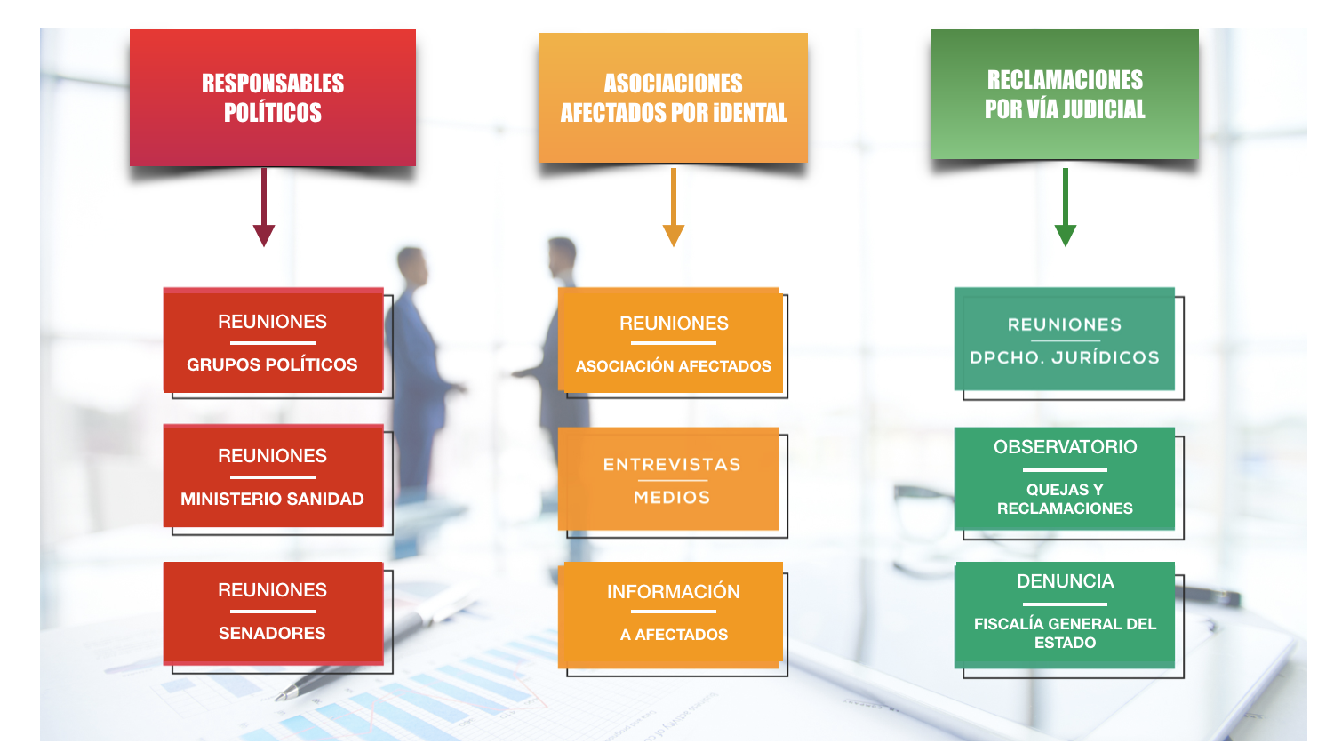
05
Actions by the Organisation of Colleges
POLITICAL
LEADERS
CONSUMERS
ASSOCIATIONS
LEGAL
ACTIONS
MEETINGS WITH POLITICAL PARTIES
MEETINGS WITH CONSUMERS
MEETINGS WITH LAWYERS
MEETINGS WITH THE MINISTRY OF HEALTH
OBSERVATORY OF CLAIMS AND COMPLAINTS
INTERVIEWS IN THE MEDIA
MEETINGS WITH DEPUTIES AND SENATORS
INFORMATION TO AFFECTED PEOPLE
GENERAL STATE PROSECUTOR OFFICE COMPLAINT
DIPUTADOS

Slide 11
5
Actions by the Organisation of Colleges
In the judicial sphere
The Spanish Dental Association is personified in the criminal proceedings initiated before the National High Court
The Spanish Dental Association is collaborating in all the aspects in which it has been requested, in addition to proposing the following actions:
                1. Application for modification of advertising regulations in order to be merely informative, not incitative to consumption.
                2. Application for modification of the Professional Societies Act so that the organisation of colleges can control companies in an ethical way.
                3. Intrusism: trying to harden the penalties.
                4. Request for greater control by the health authorities of health centres,.
                4. Collaboration with patients: information, reports, etc.
                5. Opening of sanctioning procedures to collegiate members by the Organisation of Colleges.
In the political sphere
DIPUTADOS

Slide 12

“Without teeth, without money and frightened”
16/11/2018

