Slide 1

CED-DOC-2018-093-E
SURVEY RESULTS
CORPORATE DENTISTRY
BTF INTERNAL MARKET
OCTOBER 2018

Slide 2



















Feedback received from
Austria
Czech Republic
Denmark
Estonia
Finland
France
Germany
Ireland
Italy
Latvia
Lithuania
Malta
Netherlands
Norway
Portugal
Spain
Slovakia
Switzerland
UK

Slide 3
LEGAL SITUATION - I
What are the rules regarding the ownership of a dental chain?
There is no legal prohibition about that a non-dentist owns a health institution (dental practice). The law does require a dentist to organize and direct the dental clinic. In 2007 "The Professional Services Firm Law (professional companies law)“ was approved, which was a way to regulate this kind professional firms and services run by a professional (lawyer, dentist, architect …). The professional companies can adopt any legal corporate form existing in our legislation. This Law is also positive because "professional companies" have to be registered in the Spanish professional chambers and are also under the obligation of the ethical code, so in case of misbehave a process can be open for paralyzing the wrong acting. Nevertheless, this legal text has not been so relevant after some jurisprudential interpretation, letting third party outside the professional sector to own a company that provides professional services.
The Dentists Act 1985 prohibits incorporation of dental practices by dentists but as this legislation relates to dentists rather than to dentistry this does not preclude ownership of practices by non-dentists. There is some evidence to suggest that some dentists have incorporated their practices without any sanction by the Dental Council, the regulatory body for the profession. The provisions in the 1985 Act relating to incorporation are expected to be repealed in new legislation expected to be published imminently.
To receive public reimbursement the dental office and company must follow a series of rules and regulations, one being that "the decisive influence in the company must rest with a dentist”, as the dentist have the ultimate responsibility for diagnosis, prophylaxis and treatment. The chains can own companies up-stream, but the actual clinic (dental treatment facility and the surrounding legal unit, i.e. "the practice Company") must be legally in the hands of a dentist with no less than 50%
Notes:
Spanish Link: https://www.boe.es/buscar/act.php?id=BOE-A-2007-5584
Slovakian link: https://www.slov-lex.sk/pravne-predpisy/SK/ZZ/2004/578/20180701
French link: http://www.igas.gouv.fr/spip.php?article690
German links: https://www.sozialgesetzbuch-sgb.de/sgbv/95.html https://www.gesetze-im-internet.de/zo-zahn_rzte/BJNR005820957.html https://www.bzaek.de/fileadmin/PDFs/recht/mbo.pdf

Slide 4
LEGAL SITUATION – I – CONTINUED
What are the rules regarding the ownership of a dental chain?
In the Federal Republic of Germany dentists are allowed to work in a solo practice or practice partnership in all corporate structures that are admissible to the dental profession if it is guaranteed they practice on their own account, professionally, independently and on the basis of the liberal dental practice (see Sections 16 and 17 of the Rules of Professional Conduct for dentists as well as Section 95 (1) and (1a) of Social Security Code (SGB V) in conjunction with Sections 19ff Licensing Regulations for Statutory Health Insurance Dentists (ZVZ). In most of the chamber sections, pursuant to the enabling act (chamber law for healthcare professions), practising dentistry is not only permitted to individuals or corporates under civil law but also to legal persons established under private law. According to the decision of the German Federal Court of Justice in 1993, ambulant dental services may also be provided by a private limited company (German Federal Court of Justice, judgement of 21 November 1993, file no. I ZR 281/91). Furthermore, pursuant to Section 95 (1a) of Social Security Code, licenced dentists, licenced hospitals, providers of non-medical dialysis services, non-profit institutions and local authorities are allowed to establish interdisciplinary medical care centres and, since 2015, have been permitted to set up medical care centres (so-called MVZ) of the same professional group. These medical care centres may be managed under the legal form of a private company, a registered cooperative company or a limited company or may be governed by public law. (Link1, Link2, Link3). The professional code of conduct dentists not being implemented in all Federal States, constitutes the following pursuant to Section 17a: “Legal persons governed by private law aiming at practising dentistry can only be established and run by dentists and members of the professions stated under Section 17 (1). Dental shareholders are obliged to work as dentists in the corporation. Besides, the following must be ensured: a) The corporation is led on the responsibility of the dentist The majority of managing directors must consist of dentists b) The majority of corporate shares and voting rights are due to dentists c) Third parties do not have a share in profits.” The German Dental Association has launched an initiative to incorporate this regulation into the German Federal Law. Pursuant to Section 95 (1a) of Social Security Code, medical care centres may also be established by non-dentists under the legal form of a private company, a registered cooperative company or a limited company or under the legal form regulated by public law. Accordingly, licensed hospitals, providers of non-medical dialysis services, non-profit institutions and local authorities may establish medical care centres. In addition, other non-dental investors may meet the requirements for establishing medical care centres when purchasing a hospital or a non-medical dialysis provider.
Notes:
Spanish Link: https://www.boe.es/buscar/act.php?id=BOE-A-2007-5584
Slovakian link: https://www.slov-lex.sk/pravne-predpisy/SK/ZZ/2004/578/20180701
French link: http://www.igas.gouv.fr/spip.php?article690
German links: https://www.sozialgesetzbuch-sgb.de/sgbv/95.html https://www.gesetze-im-internet.de/zo-zahn_rzte/BJNR005820957.html https://www.bzaek.de/fileadmin/PDFs/recht/mbo.pdf

Slide 5
LEGAL SITUATION – I – CONTINUED
What are the rules regarding the ownership of a dental chain?
We do not have any legislation which prevents to occur the dental chains. The current legal situation is adjusted by Act no. 578/2004 Coll. in which the necessary conditions for receiving permission for providing healthcare from competent authority for legal person are the approved space and dentist with license on professional guarantor.
Only non-profit organizations can own and run dental chains. This report of the Sanitary Authority (IGAS) pinpoints the rules.
The normal rules for LTD and other corporate forms existing in Italy. Some forms of STP (Società tra professionisti or Professional Company) are also allowed, with 2/3 of the ownership held by dentists and under the laws of the GMC and 1/3 by outside capital. They are not yet widespread and they are obviously neglected by big capital investments. Relevant law here.
The permission to profit from ‘the business of dentistry’ is regulated through the Dentists Act 1984 (as amended). Those profiting from the business of dentistry must be registered dentists or dental care professionals. Specific rules apply to the composition of the board of directors of corporate bodies. The majority of directors must be registered dentists or dental care professionals.
No special rules or regulations.
Notes:
Spanish Link: https://www.boe.es/buscar/act.php?id=BOE-A-2007-5584
Slovakian link: https://www.slov-lex.sk/pravne-predpisy/SK/ZZ/2004/578/20180701
French link: http://www.igas.gouv.fr/spip.php?article690
Italian Link: http://www.gazzettaufficiale.it/eli/id/2017/08/14/17G00140/sg
UK link: http://www.legislation.gov.uk/ukpga/1984/24/section/41

Slide 6
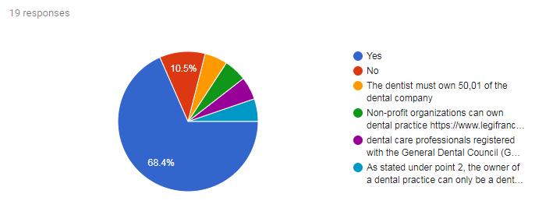
LEGAL SITUATION - II
Can a non-dentist own a dental practice?
* Dental care professionals registered with the General Dental Council (GDC) can own dental practices in the same way as dentists. Specific rules apply to non-dentists involved with corporate bodies.
*The owner of a dental practice can only be a dentist. This has to be distinguished from the ownership of a medical care centre. Pursuant to Section 95 (1a) of Social Security Code licensed hospitals, providers of non-medical dialysis services, non-profit institutions and local authorities may establish a medical care centre. A prerequisite is, however, that the professional medical management remains under the control of a dentist. As medical care centres may also consist of the same professional group, as a result of the Care Empowerment Law (Statutory Health Insurance-Care Empowerment Law 2015) and consequently dental practices may be changed into (dental) medical care centres (MVZ), non-dentists stated in Section 95 (1a) of Social Security Code V may also be the owner of a dental care centre (possibly resulting from a dental practice). Moreover, investors who do not come under Section 95 (1a) of Social Security Code V may comply with the requirements for setting up a medical care centre when purchasing a hospital or a non-medical dialysis provider.

Slide 7
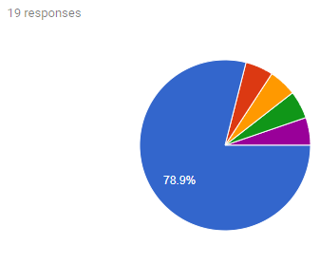
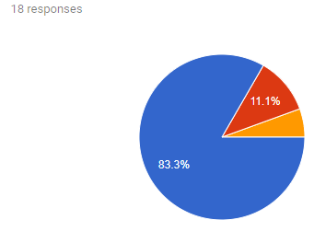
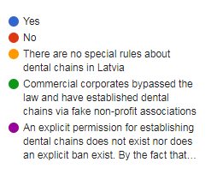
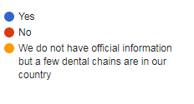
LEGAL SITUATION – III
Are dental chains allowed in your country?*
If yes, do dental chains exist in your country?
* An explicit permission for establishing dental chains does not exist nor does an explicit ban exist. By the fact that non-dentists defined by Section 95 (1a) of Social Security Code V are allowed to establish medical care centres and the possibility to establish pure dental care centres (so-called Z-MVZ), the lawmakers have indirectly laid the foundations for establishing dental chains. This drives increasingly towards creating corporate-like structures that are in the hands of yield-oriented investors.

Slide 8
LEGAL SITUATION - IV
If no, which law prevents dental chains in your country?
Dental Act (Zahnärztegesetz)

Slide 9
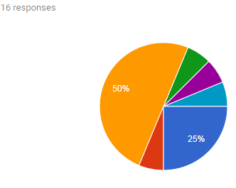
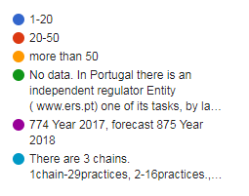
DENTAL CHAINS – I
Approximately how many practices are run by chains in your country?

Slide 10
DENTAL CHAINS – II
On average how many a) employees and b) subsidiaries do they have?
It differs a lot. Some practices are quite big, and others have 3-4 employees incl. the owner-dentist
a) 2-5 each b) 2-5 each
a) 3.99 employees b) 3.2 subsidiaries
The number of subsidiaries vary a lot in the 5 biggest dental chains. The biggest dental chain has 31 subsidiaries, while the rest have from less than 5 to 10-15 subsidiaries. The number of employees in these subsidiaries also vary substantially. The biggest subsidiary has 43 employees, and the smallest 2. If you calculate an average, the subsidiaries have an average of about 15 employees.
10 and more dentists
biggest is Estonian contains 12 dental offices ( 1 big) approx 100 dentists)
There is no empirical evidence to provide but most employ at least two-three dentists per office and there are chains with over 30 offices across the country.
About 70
200-500
Rough estimates: a) 200 (dentists); b) 50 (practices)
Estimated about 5000 dentist. We do not include other dental chair professionals
The largest chain, mydentist, has 7600 employed and self=employed personnel over 650 subsidiaries. This is an average of 11 staff for each practice. Other dental corporates vary in size.

Slide 11
DENTAL CHAINS - III
Can you estimate what percentage of practices is part of the top 5 chains?
Little, mostly there are 2-3 clinics under the same ownership and most cases they are dentists
2,5 %
Around 5 %
Under 10%
Around 10%
20%
Around 22%
There are 50 brands with at least 5 practices; among these ones the top 5 have 374 practices out of 774 representing 48,3%
Around 50 % of practices in the private sector

Slide 12
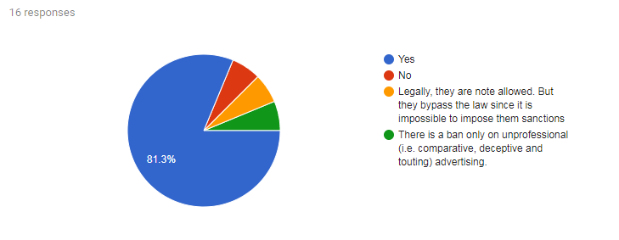
DENTAL CHAINS - IV
Are chains allowed to advertise their services in your country?

Slide 13
DENTAL CHAINS & PROFESSIONAL PRACTICE - I
Do you have any reports about the quality of the dental services provided by dental chains (positive and/or negative)?
Many reports asserted the very bad quality dental care provided in chains practices
Yes. The Spanish Dental Association has elaborated a Complaint Report that was shared with the CED.
We have positive (mostly as an advertisement) and also negative.
No, but there does not seem to be a bias in complaints or others issues regarding quality in treatment from chain-practices.
There are rumors but not certified reports about overtreatments and induction to therapies; others about pressure put on dentist by managers of the ownership (who use to stay in the operating room during the first visit) towards some kinds of therapy instead of others. All of this is obviously always denied by the ownership and often not even reported by patients or employed dentists simply because they don't want "problems"
There are neither positive nor negative reports on the quality of dental services provided by dental chains. However, it is clear that the services provided by dental chains are focused on big cities, metropolitan areas and high-income rural areas. This development compromises the region-wide dental care and may lead to a deterioration of quality of care in the long run. Focusing on services provided in metropolitan areas as well as the chance for yield-oriented corporates to establish a medical care centre by purchasing a hospital, gives reason to believe that therapy decisions are taken according to turnover and yield aspects and are less oriented towards the patient’s well-being which might have a negative impact on the overall quality of care.
Research papers have been published in the British Dental Journal in September in relation to dental corporate chains. The paper on “Dental corporates abroad and the UK dental market” makes a number of comments about a lowering of quality in some instances.
Only patients complaints.
Notes:
French links: https://www.lelanceur.fr/scandale-dentaire-dentexia-le-defenseur-des-droits-ouvre-une-enquete-2/; http://www.liberation.fr/france/2016/07/04/implants-dentaires-a-bas-cout-un-scandale-silencieux_1463914 ; https://www.francetvinfo.fr/sante/affaires/centres-dentaires-dentexia-apres-le-scandale-des-patients-toujours-en-attente-de-soins_1816123.html

Slide 14
DENTAL CHAINS & PROFESSIONAL PRACTICE - II
Do you have any reports about unethical behaviour of dental chains towards patients?
As an example, the Dentexia chain, shut off by judicial decision.
No, but we have seen a very agressive marketing from some smaller chains.
There are no specific reports available. However, a therapy decision taken according to turnover and yield aspects constitutes an unethical behaviour. A decision taken this way is detrimental to patients and constitutes a breach of dentists’ duties.
In advertising, actually, the GMC has no right to overview or certificate the message before its broadcast and there are cases of misleading advertising towards patients withdrawn only by the force of the competition and market agency and however too late.
Research papers have been published in the British Dental Journal in September in relation to dental corporate chains. There can be conflicts of interest between patient care and chain profitability.
Yes, we are familiar with chains who sell so called “dental tourism” services and who do not properly explain the consequences of receiving treatment abroad. For instance, dental treatment outside Norway is not covered by the mandatory insurance that all dentists practicing in Norway are obliged to have. This information is often not conveyed in the advertising by chains who also offer treatment abroad.
Notes:
French links: https://www.marianne.net/societe/ligas-saisie-du-scandale-des-centres-dentaires-bas-prix-dentexia; https://www.youtube.com/watch?v=nMs8azOi0ko

Slide 15
DENTAL CHAINS & PROFESSIONAL PRACTICE - III
Do you have any reports about issues with the provision of care to patients where chains exited the market?
Yes. Vital Dent , dental chain, exited the market since they were sanctioned by public health authorities and also by court of justice. See more at https://www.omd.pt/?s=vital+dent+&lang=pt-pt
Yes: http://www.igas.gouv.fr/spip.php?article546
Yes: http://iltirreno.gelocal.it/prato/cronaca/2018/04/05/news/lo-studio-chiude-all-improvvisodecine-di-clienti-senza-dentista-1.16671502?refresh_ce; http://nuovavenezia.gelocal.it/venezia/cronaca/2017/04/02/news/centro-dentisticoabbandonato-pazienti-con-interventi-da-finire-1.15135613; http://www.odontoiatria33.it/approfondimenti/14610/quando-una-clinica-odontoiatrica-chiudee- lascia-senza-cure-i-pazienti.html http://www.ilsussidiario.net/News/Cinema-Televisione-e-Media/2016/2/18/VITALDENT-HACHIUSO-Video-anche-le-sedi-italiane-a-rischio-Striscia-la-Notizia-/680567/
Yes. When corporates are no longer able to provide care at particular practice locations, patients can be left without dental care, including that provided through the NHS.

Slide 16
ROLE OF DENTAL ASSOCIATIONS/CHAMBERS
Do dental associations/chambers or regulatory bodies have the power to impose disciplinary sanctions to the corporate ownership or dental chains for unethical behavior? Do they have any other kind of control over the activity of these corporates/companies or dental chains?
Slovak Chamber of Dentists has power to impose disciplinary sanctions only to dentists who are its member (we do not have compulsory membership) not to legal persons or owners who are not dentists.
No - as far as the first question As regards the second question, only over the medical director, who is an employee of the ownership and has only responsibilities (civil and criminal liability) but not the right to decide how to spend the budget of the office.
Companies are subject to legislation as it relates to companies and the appropriate regulatory authorities and likewise dentists practicing in chains are subject to the control of the Dental Council.
National Supervisory Authority for Welfare and Health (Valvira) supervises healthcare professionals and medical facilities both in private and public sector.
As professional chambers we do not have the power to sanction a dental chain, just over the professional or over the “professional services firm”, and these chains are not declared as professional services firm. Just the control of the Administration : Ministry of health and the territorial Health Council.
The association is the dentists’ representative, and fines and/or other sanctions a vested with the Supervisory Authorities

Slide 17
ROLE OF DENTAL ASSOCIATIONS/CHAMBERS - CTND
Do dental associations/chambers or regulatory bodies have the power to impose disciplinary sanctions to the corporate ownership or dental chains for unethical behavior? Do they have any other kind of control over the activity of these corporates/companies or dental chains?
The regulatory Body of dental practice (Conseil de l'Ordre) isn't empowered to impose sanctions to non-dentists. So, the association director, when he's a non-dentist (which is usually the case) can't be worried when any ethical misbehavior is committed in the practices he runs.
The regulatory body, the General Dental Council, is able to bring fitness to practise proceedings against dentists and DCPs who are directors of corporates. The General Dental Council has the power to register corporate providers but it does not exercise that power. The Care Quality Commission regulates the provision of dental services by corporates on an individual practice basis.
The Norwegian Dental Association (NDA) can only impose sanctions for unethical behavior to the corporate ownership and dental chains if the owners are dentists who also are members of the NDA. Otherwise the NDA has no control over the activity of these corporates/companies or dental chains.
There is no different control, the same a for normal dentist or dental clinics
The following measures can be applied only to the members of Lithuanian Dental Chamber: hearing in the court of the honour. The verification of the licensed activity is carried out in the case of complaint.
Since we do not have dental chains we do not know the power we have but we do know that a licence to own a dental practice is given to a dentist and the dentist is regulated by the medical council
No

Slide 18
ADDITIONAL COMMENTS
The chains that are established in Norway have different chain-structures. For instance, not all of them employ the dentists. Instead the corporate who owns the dental chain enter into different types of cooperation with self-employed dentists/owners of dental practices. In some cases, only back office/administrative services are rendered, but in most cases a more complete concept is sold to the owners of the dental practices to integrate them in the chain structure.
We have an increasing number of dental chains.
We believe that the current scenario in Portugal turns the dentist the weaker part of the chain, under the present free and deregulated competition rules. We congratulate CED for the initiative that we have been asking for many years now. This very same rules imposed by EU institutions eg European Commission are not applicable in many other countries within the EU. Harmonization would be a great most value.
The problem is that the new dentists want to work part-time. Then is it impossible to run a practice by your own.
In Italy some cases are reported of money laundering acted by N'Drangheta using dental practices not owned by dentists and under their control as stated by the AIO-Eurispes 2014 Report.

Slide 19
THANK YOU FOR YOUR ATTENTION

