Slide 1

CED-DOC-2018-067-REV1-E
SURVEY RESULTS
GDPR
CED GENERAL MEETING
OCTOBER 2018

Slide 2















Feedback received from
Austria
Belgium
Croatia
Czech Republic
Denmark
France
Greece
Ireland
Netherlands
Norway
Poland
Spain
Slovakia
Sweden
Switzerland

Slide 3
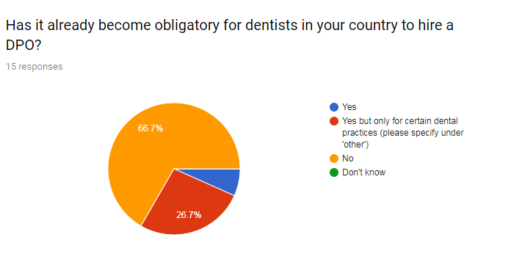
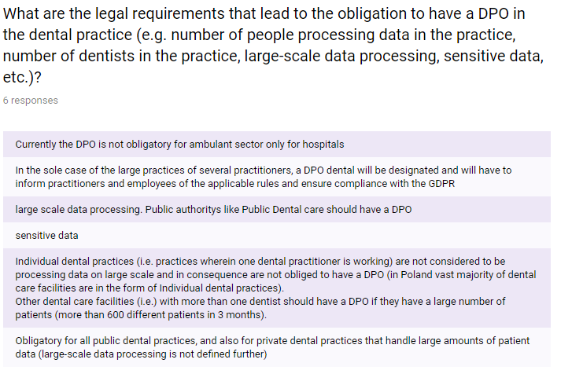
DPO OBLIGATORY - OBLIGATION

Slide 4
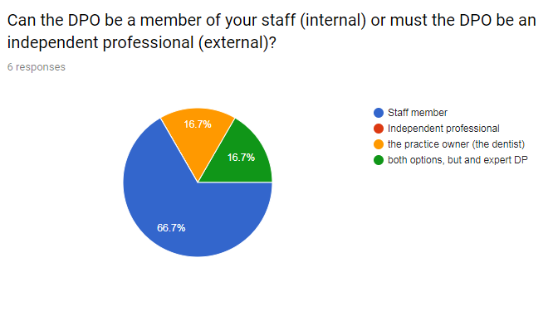
DPO OBLIGATORY - APPOINTMENT

Slide 5
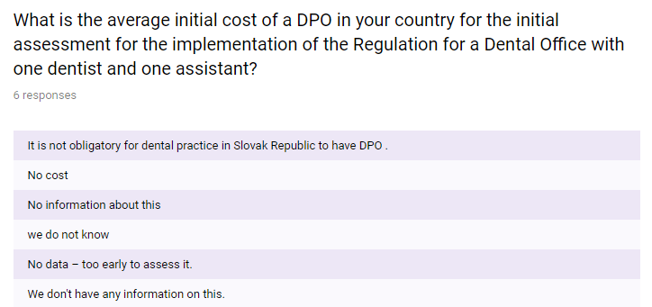
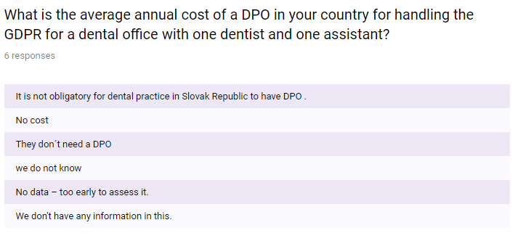
DPO OBLIGATORY - COSTS

Slide 6
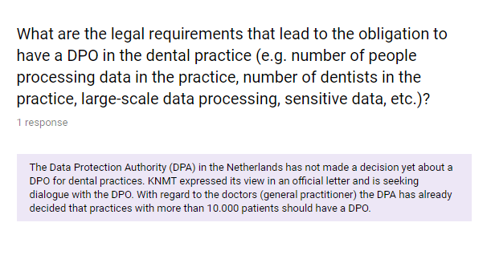
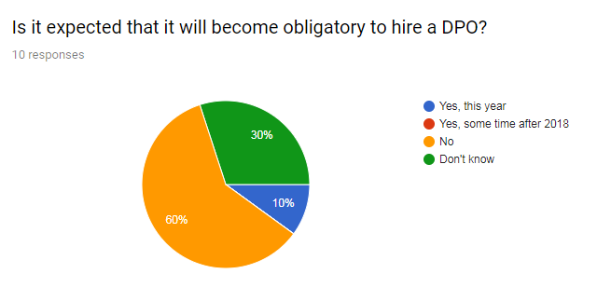
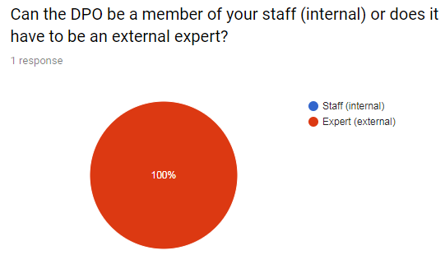
DPO NOT OBLIGATORY

Slide 7
THANK YOU FOR YOUR ATTENTION

