Slide 1

BTF AMR
Hans Schrangl, BTF Chair
CED General Meeting
Brussels, November 2018 GM

Slide 2
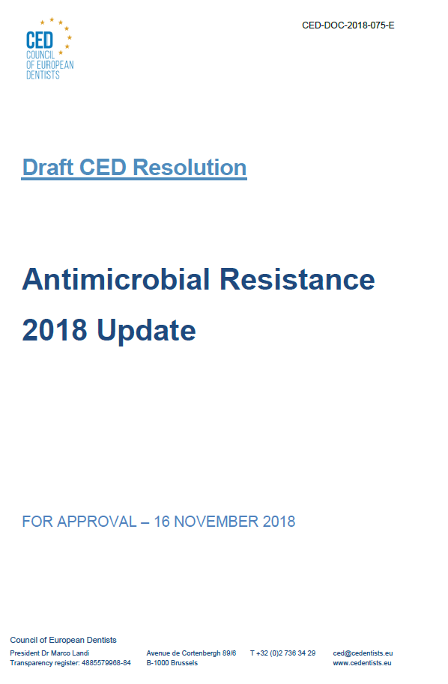
AMR RESOLUTION
Notes:
Dear all, the BTF AMR prepared an update to the original 2014 CED resolution on AMR to reflect the progress that has been made on the topic in the last years. As you all know and as we heard this morning in the presentation from Dr Monnet the topic is high up on the policy agenda these days.
We will now show you the updated resolution and ask you to share any comments you may have. We will then vote on the adoption of the updated resolution.

Slide 3

JOINT ACTION ON AMR
Mission: Foster synergies among EU Member States by developing and implementing effective One Health policies to fight the rising threat of AMR and to reduce HCAI.
Objectives:
  Identify and test evidence-based measures to address AMR and HCAI in different contexts and provide recommendations to policymakers.
  Bring together different networks of policymakers, experts and organisations working on AMR and HCAI.
  Promote: 1. The One Health approach; 2. One Health in all policies concept; 3. Health in all policies concept.
  Produce concrete recommendations and promote awareness and commitment by governments and stakeholders for a European contribution to international initiatives.
Notes:
The Joint Action on AMR has been running for one year now. On the slide you can see the mission and objectives, which is basically to promote one health policies at Member State Level.
The CED is not involved in any of the Work Packages at the moment due to the nature of the Joint Action. However, the CED attended the first annual meeting and the stakeholder forum of the Joint Action in Vienna last week to understand the progress and the outputs of the different Work Packages. Unfortunately, it seems that there is not much progress at the moment and that stakeholders other than the Member States involved in the projects are not very well involved.
If there is a possibility for the CED to engage we will do so but it remains to be seen if there is any valuable output from this Joint Action.

Slide 4
COLLABORATION WITH ECDC
Survey of healthcare workers knowledge and attitudes about antibiotics and antibiotic resistance
Timeline: Survey to be disseminated in January and publication of results in April
Target: doctors, dentists, nurses, midwives, pharmacists, hospital managers and associated healthcare workers
Goal: create a first baseline for future policy recommendations
Notes:
As you heard this morning, the CED is working more closely with the ECDC
ECDC and Public Health England are working on a survey on healthcare professionals knowledge of and attitudes towards AMR. Together with other stakeholders we are helping to fine tune the survey and make it relevant for healthcare professionals. The survey should be sent out in January and we will share it with the CED members and hope that you can encourage your members to participate in it.
The goal is to create a first baseline overview of our professions’ attitudes and knowledge of the issue that can then be used for future policy recommendations.

Slide 5
THANK YOU FOR YOUR ATTENTION

