Slide 1

BRUSSELS OFFICE REPORT
Nina Bernot, Lea Pfefferle and Aneta Tyszkiewicz
Brussels, 16 November 2018

Slide 2
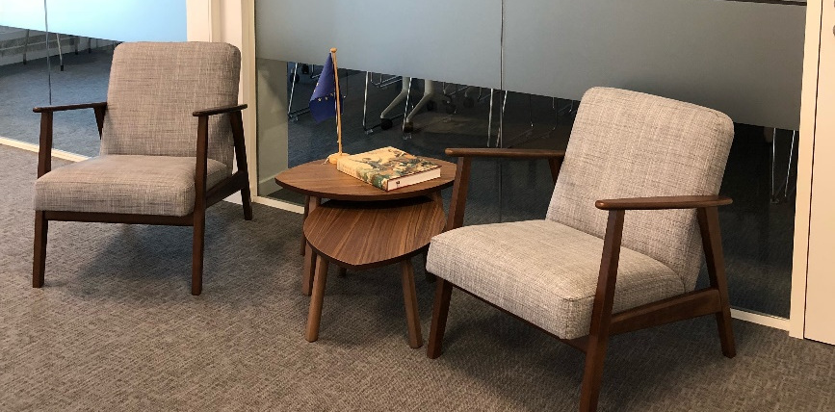
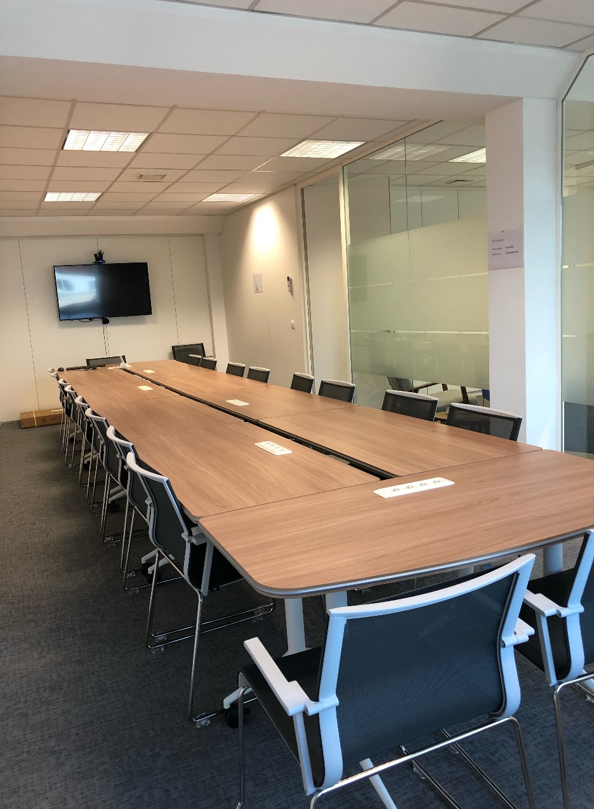
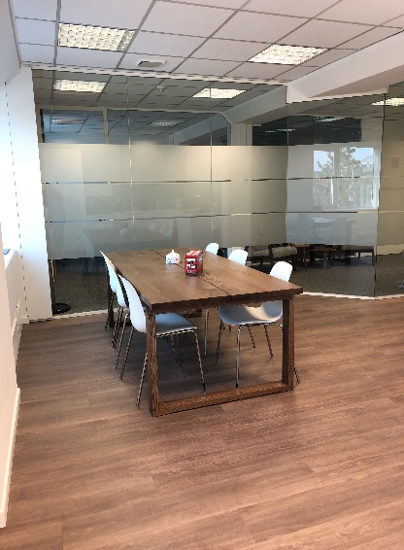
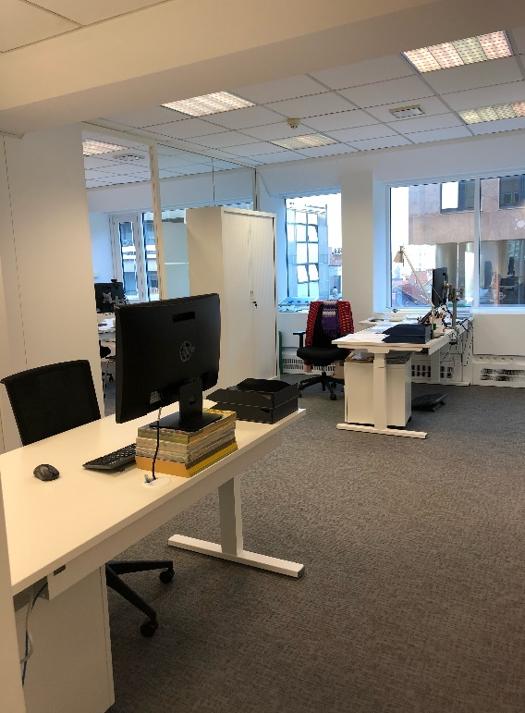
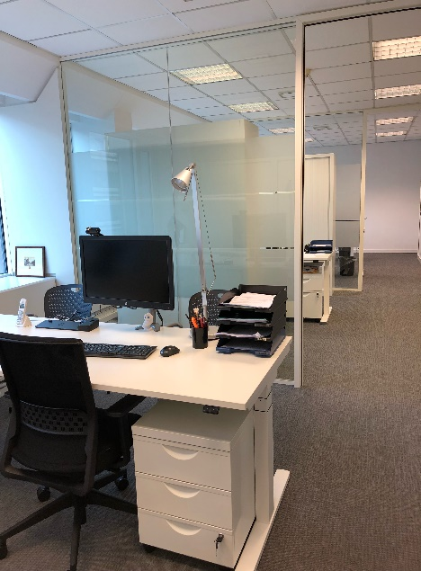
NEW CED OFFICE
Notes:
Brussels Office moved to Avenue de Cortenbergh 89 (5th floor) at the end of August
Facilities include a meeting room for 20 persons (sufficient for Board and WG meetings) and video-conferencing technology
We hope to welcome you soon, either for a CED meeting, as a national delegation or an informal visit

Slide 3
GENERAL MEETING HIGHLIGHTS
Board elections
Vote on new Affiliate Member and Observer Associations
Resolutions on Antimicrobial Resistance, on Corporate Dentistry, and on Data Sharing as Part of eHealth
Statement on Medical Devices Regulation - CAD/CAM
Lunch topic tables
Notes:
Lunch topic tables:
Sugar
Funding
Feedback on services
Young dentists
Professional liability
Medical devices

Slide 4
GENERAL MEETING: WHAT’S NEW?
Voting on policy – voting cards
Yes
No
Abstain

Slide 5
POLITICAL BACKGROUND
State of the EU 2018: health not mentioned
Multiannual Financial Framework (MFF) 2021-2027: no dedicated Health Programme
Brexit: UK will leave the EU on 29 March 2019, draft Exit deal negotiated
Commission Work Programme 2019: legislative cycle coming to an end
EU Elections May 2019: New Commission with no Commissioner and DG for health?
Notes:
MFF: funding for health initiatives possible under Horizon Europe (research) or European Social Fund Plus (ESF+)
Commission Work Programme 2019
Communication on endocrine disruptors
Recommendation for European Electronic Health Record format
Fitness check of water framework and urban waste water Directives
BREXIT: CED co-signed a joint letter of health professions to the UK and EU negotiators, will attend a meeting with EU negotation team on 22 November

Slide 6

NEXT COUNCIL PRESIDENCIES
2019-2020 Trio:
  Romania-Finland-Croatia
Romanian priorities
  Converging Europe: growth, cohesion, competitiveness, connectivity
  A safer Europe
  Europe, a stronger global actor
  Europe of Common Values

Slide 7
CED WORKING GROUPS & TASK FORCES
Mailing will be sent after the GM, asking you to:
  Confirm continued participation in WGs and TFs
  Nominate new members (open to Members and Affiliate Members)

Slide 8
REMINDERS
Please sign CED Consent Form (Data Protection) and leave it at the welcome desk
All presentations, documents and reports will be available on the website
Any questions: please contact the CED Office!
GM evaluation survey

Slide 9

TWITTER
Follow us on Twitter: @CEDentists

Slide 10
THANK YOU FOR YOUR ATTENTION

