Slide 1

WG Oral Health
Henk Donker, WG Chair
CED General Meeting
Brussels, November 2018 GM

Slide 2
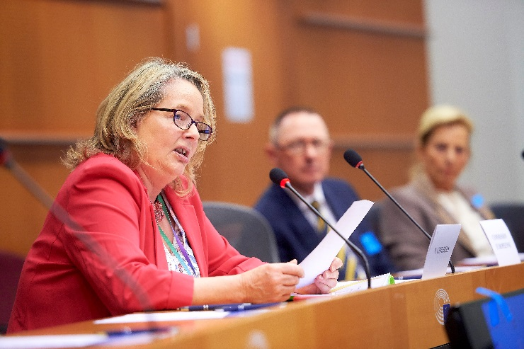
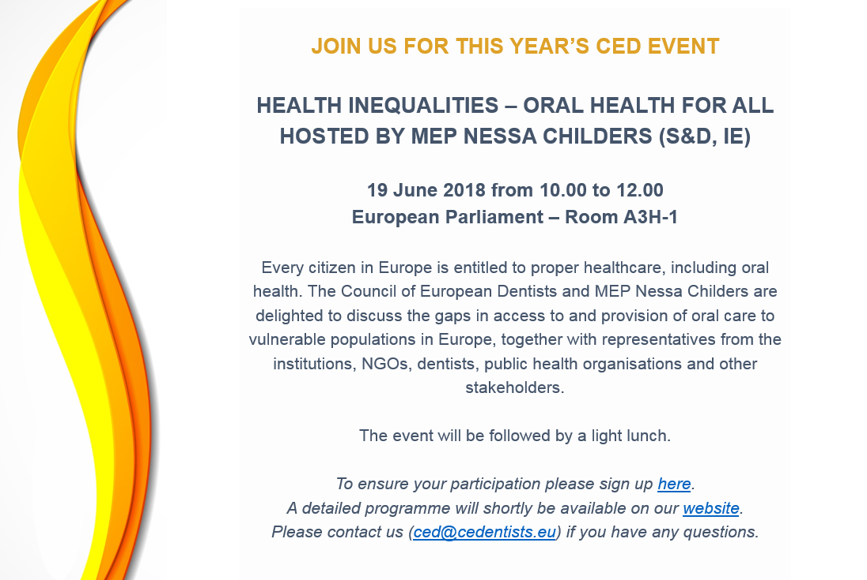
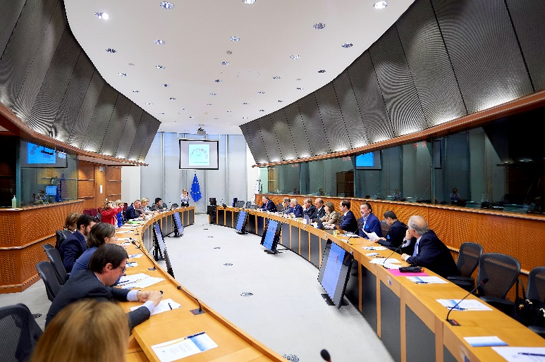

CED EVENT – HEALTH INEQUALITIES
Notes:
- The CED public event took place on 19 June and was hosted by MEP Nessa Childers.
- It was attended by approximately 25 people, with speakers from the EP, Commission, academia, dental practitioners, NGOs and the CED.
It was a good opportunity to exchange views on the need for more policy action in the field of provision of and access to dental care for disadvantaged populations. We heard many examples of encouraging work that is being done in the field but also heard about the gap in funding and the lack of political will at times to address the problems that vulnerable populations have.

Slide 3
WHITE PAPER ON PREVENTION
Follow-up to the public event on health inequalities
Focus on the importance of prevention for oral health
Timeline: Presentation to the delegates at May 2019 GM
Notes:
During the Event on health inequalities, the representative from the European Commission also encouraged the CED to prepare a white paper on prevention.
This White Paper will provide an opportunity for the CED to promote the importance of prevention. It will touch upon the link between oral health and prevention, talk about the EU’s role in prevention and discuss key asks from the CED.
The Working Group is currently in the process of writing the paper, underpinned by existing data. In addition, the Working Group is considering to ask the members to provide best practice examples of prevention programs in their countries.
The aim is to have this white paper adopted at the next General Meeting in May in Vienna and to present it to the newly elected Commission and European Parliament later in 2019. We will also explore if other important policy making organizations like the WHO can endorse the paper.

Slide 4
THANK YOU FOR YOUR ATTENTION

