Slide 1

WG EDUCATION AND PROFESSIONAL QUALIFICATIONS
Paulo Melo, WG Chair
CED General Meeting
Brussels, 16 November 2018

Slide 2
Survey to Deans of Dental Schools
The Survey was sent to Deans of Dental Schools across Europe
It received 37 replies from various universities from 17 countries across Europe
Results demonstrate that the majority of the respondents are strongly in favor of revision of the Annex V.3/5.3.1, and have already amended their curricula more than a few years ago
Notes:
CED WG EPQ developed a survey on the subjects of the study programme in Annex V.3/5.3.1 of the Professional Qualifications Directive (PQD).
The survey was first shared with all CED Members, asking them to potentially share it with their national dental schools’ contacts. At end of August, the CED Brussels Office also shared the survey, using contacts from the EU Manual of Dental Practice.
The deadline for contributions to the survey was extended to 31 October. So far 32 universities across Europe have contributed.

Slide 3
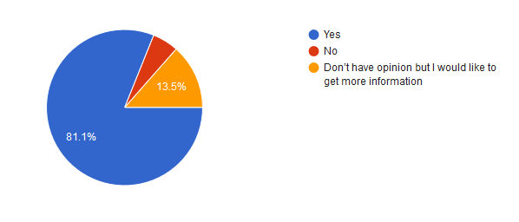
Survey to Deans of Dental Schools
Do you find it important to update the Annex V.3/5.3.1 of the Directive 2005/36/EC (PQD)?
Notes:
As you can see, 81.1% of the respondents believe that it is important to update the Annex V.3/5.3.1

Slide 4
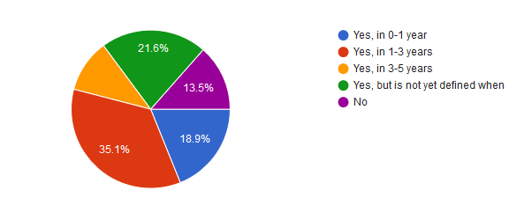
Survey to Deans of Dental Schools
Is there an intention to conduct any update of dental curriculum in a near future?
Notes:
More importantly, as you can see only 13.5% of the respondents do NOT intend to conduct an update to their curriculum in the future – the vast majority intend to conduct an update in the period of 0-5 years time.

Slide 5
CED - ADEE Relationship
The CED was concerned about the EDHF - ADEE Consultation on a common education framework (CEF) for dental hygienists in Europe
The CED prepared a letter to ADEE on this topic, stressing the negative impact of overlapping professional competences
Notes:
Since this activity ultimately might lead to the automatic recognition of dental hygienists all over Europe the WG decided 1) to not reply to this Consultation, nor to forward it to Members and 2) to sent a letter ADEE, regretting the content of the document and highlighting the risk of overlapping professional competences in relation to the Consultation in question.
WG Chair Paulo Melo developed this letter – the text was shared with the Board for approval.
The letter aims to highlight the necessity to reconsider CEF, underlining that the dentist has the leadership role in the dental team; the text also highlights that CED and ADEE have been able to enjoy a productive and workable relationship so far

Slide 6
Endorsement of FEDCAR Annex
FEDCAR prepared a position paper on Accreditation of Dental Education in Europe
The CED endorsed the Annex of this document, calling for an additional measure to ensure that quality of dental education, and especially the clinical component, is assessed:
a) Against a minimum acceptable standard; and
b) Independently of the institution providing the training
The Annex is also endorsed by the ADEE and EDSA
Notes:
The CED made one minor amendment to the text of the Annex and apart from that flagged to FEDCAR that the last sentence of the document (‘Member States must ensure the quality of the delivered qualifications in Chapter III, Title III, by setting up a mandatory system of a public, regular and independent accreditation of their dental studies. Once obtained, the accreditation is notified to the Commission.’) could result in revision of the PQD revision, and introduction more changes in partial access. As suggested during the WG EPQ last meeting, this could be proposed as an administrative act rather than included on a possible PQD revision.

Slide 7

One Health Collaboration
Notes:
CED is co-organising this event together with Standing Committee of European Doctors (CPME) and the Federation of Veterinarians in Europe (FVE), and their student association equivalents.
The session, titled ‘Implementation of One Health in undergraduate education: Doctors, dentists and veterinarians working together from curricula to practice’ is to take place in Paris on 5 December
The session aims to bring together academics, policy-makers, professionals and students from medical, dental and veterinary fields in France, Belgium, Luxembourg and the Netherlands. The objective is to encourage an open discussion and exchange views on how to implement the One Health approach in undergraduate education and foster interdisciplinary education and follows- up on the letter co-signed by the six organisations last year.
It is also important to consider the need for the CED to work on developing a position on the topic of interprofessional collaboration

Slide 8
Next steps for the WG
Next online meeting of the WG will be organised in February 2019
The WG will focus on updating the Resolution on Continuous Professional Development
The WG will start planning the next steps around optimising the use of the result of the survey to Deans of Dental Schools to call for an update of the Annex V.3/5.3.1 e.g. meeting with MEPs

Slide 9
THANK YOU FOR YOUR ATTENTION

