Slide 1

WG Dental Materials and Medical Devices
Jane Renehan, WG Chair
CED General Meeting
Brussels, November 2018 GM

Slide 2
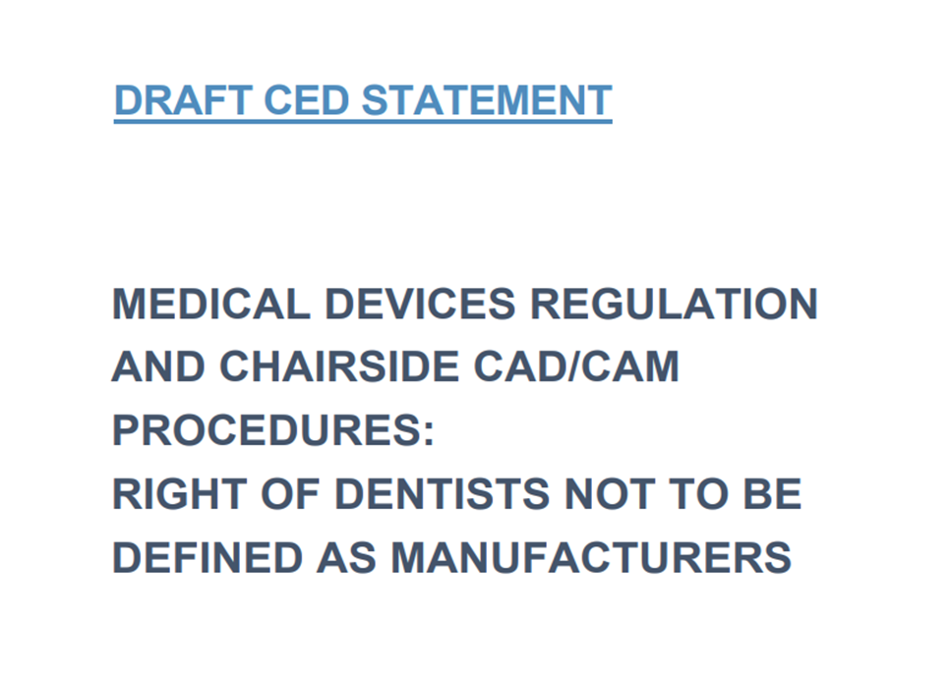
MEDICAL DEVICES
CED Statement on MDR CAD-CAM (CED-DOC-2018-074-E) was developed
It is envisaged to vote for adoption of the Statement at the General Meeting of the CED in November 2018
Notes:
With the Statement the CED wishes to clarify the role and competences of dentists using chairside CAD/CAM systems.
Update on implementation of MDR
The European Commission faces criticism from the industry and MEPs regarding the progress to date in the implementation of the MDR.
So, far 34 of the EU’s approximately 60 notified bodies have applied for recertification under the new rules and only two out of 18 mandatory implementing acts have been published.

Slide 3

HEALTH TECHNOLOGY ASSESSMENT
HTA is an important part of evidence-based decision-making on health in most EU countries
European Commission would like to encourage further cooperation on HTA among Member States with its current initiative
WG to continue monitoring the topic
Notes:
At the last WG meeting, Orsolya Nagy from the European Commission provided an overview on the proposed HTA legislation.
The European Commission would like to encourage further cooperation on HTA among Member States and announced at end of 2017 that it will push for an initiative on this; the initiative was adopted on 31 January 2018.
The main goals of this initiative were highlighted as allowing for new health technologies to reach patients faster, while at the same time boosting Europe’s competitiveness in the health sector.
The proposal from the European Commission has been voted at the European Parliament and is now going to the Council. It is unlikely that finalisation takes place before the European Parliament elections in May 2019.
HTA is restricted in scope – will only be applied to medical devices in class IIb and III - and may not touch on health technologies that are of relevance to the dental profession.
The WG discussed that the only relevant innovative technology coming to market in the next years could be implants with bioactive coatings.

Slide 4
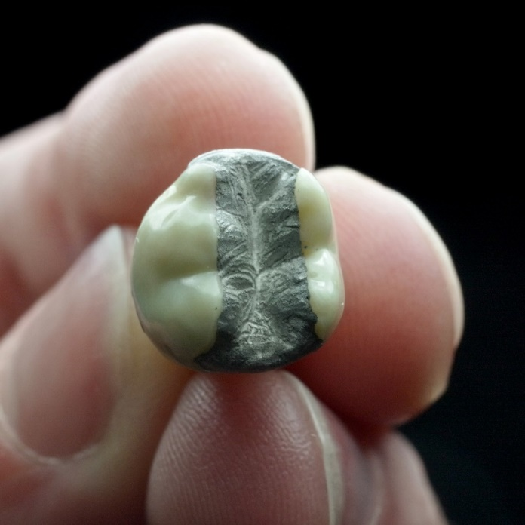
MERCURY REGULATION – NEXT STEPS
Feasibility Study
Start: September 2018
Stakeholder workshop and presentation of final first draft: Autumn 2019
Final report: January 2020
Notes:
Myself, Susie Sanderson and Lea Pfefferle we met with the Commission on 27 September to discuss the feasibility study that will investigate the possible dental amalgam phase-out by 2030.
Many thanks again to Susie who has a tremendous knowledge on this issue.
In terms of the timeline, they shared the following with us:
The work started in September 2018.
The Stakeholder workshop and presentation of final first draft will take place in autumn of 2019 and the final report is expected for January 2020.
We have raised that the stakeholder workshop is very late and voiced our concern that it may be too late to take stakeholders’ comments on board.
At the meeting we explained that it is crucial that prevention is phased up for the phase down or even a phase out of dental amalgam to be successful. The Commission delegates were interested to hear about the aspect of prevention and said they would take this into account. The CED offered that we could provide contact information for experts on various issues related to dental amalgam (provided they agree to work on this) and put the contractors in touch with them.
The CED further discussed that there needs to be more funding for research and development into new materials and into the environmental impact of alternative materials.
The Commission suggested they could speak to their colleagues to place hooks in the high-level wording of Horizon Europe that could later on make it possible to have specific projects on this.
We have asked the members of the WG to provide some names of experts with us that can assist the Commission with this study.
Unfortunately we have also noted that one of the authors was also an author of the 2012 BIO IS study on dental amalgam that we have criticized.
We will therefore watch the developments closely and share more information with you when available.

Slide 5
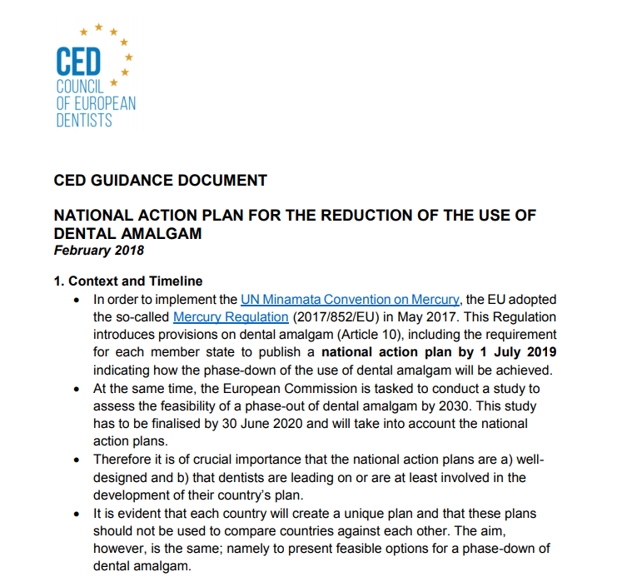
MERCURY REGULATION – NEXT STEPS
National Action Plans
National Action plans need to be in place by 1 July 2019
CED shared a guidance with members in February 2018
The Commission is meeting with Member States in early December to discuss their progress
The anti-amalgam lobby is trying to heavily influence the plans
Notes:
In addition to the feasibility study, we also discussed the National Action Plans.
As a reminder, the action plans are required to be published by July 2019 as per the Mercury Regulation and should set out how the Member States plan on reducing dental amalgam.
The feasibility study will have to take them into account, even if the timelines are very tight.
If you remember, we shared a guidance with you in February, which was resent to you in October.
The Commission will meet with the Member States in December to discuss the progress and we shared a document with the Commission to encourage them to focus on prevention and R&D in the action plans as a countermeasure to the phase-down of amalgam.
We understand that the anti-amalgam lobby is very keen on influencing the action plans and sees it as its chance for a rapid and complete phase-out.
We encourage you again to reach out to your regulators and try to be involved in the set up of such a plan.

Slide 6
TOOTH WHITENING IN PERSONS UNDER 18
Goal: Reverse the ban on tooth whitening in persons under 18 years of age
Concern: European Commission is not willing to challenge the ban
Next step: Gather national support from regulators, CDOs, paediatric organisations, health authorities
→ use the CED advocacy document
Notes:
Last year the CED prepared a dossier on the safety of tooth whitening in persons under 18 years of age.
You may remember that the Commission decided that it would not share this with the scientific committee in order to ask for a review of the ban.
In order to advance on the issue, the WG has now prepared an advocacy document and asks the CED members to discuss this issue at national level in order to put it on the agenda of the standing committee on cosmetic products.
After this meeting, you will receive an email on behalf of the WG asking for a contact person in your organisation on tooth whitening so that the CED office can keep in touch and can understand what the developments are at national level.
The advocacy document gives you an overview of what has been done already, who you can reach out to and some speaking points that you can use.

Slide 7
ISO DECLARATION OF DENTAL MATERIALS
Goal: Include the declaration of dental materials in the updated ISO 4049 (declaration mandatory for <1% of all materials and <0.1% of carcinogenic materials)
Next Step: National standardisation bodies must approve the updated ISO 4049
Ask: Be mindful of your national standardisation body’s position and get in contact if they are contradictory to the CED efforts
Notes:
The CED sent a letter to the TC 106 Dentistry in advance of their September meeting to reiterate the need to include the declaration of dental materials in the updated ISO 4049.
The ISO delegates in the relevant TC have approved the wording and it is now up to the national standardisation bodies to approve the updated ISO 4049.
The CED encourages member organisations to be aware of the position the respective national standardisation bodies are taking and to get in contact in case they are contradictory to the CED efforts.

Slide 8
THANK YOU FOR YOUR ATTENTION

