Slide 1

BTF INTERNAL MARKET
Alexander Tolmeijer, BTF Chair
CED General Meeting
Brussels, November 2018 GM

Slide 2

CORPORATE DENTISTRY
Issue: Increasing prevalence of corporate entities investing in dental practices or setting up chains
Concerns: insufficient quality, overtreatment, aggressive marketing, unethical behaviour to fraud
Next Step: The CED wants to publish a resolution on corporate dentistry
Notes:
- The BTF has focused on the topic of corporate dentistry in the last months and has prepared a resolution
In our discussions with members and through the survey we found that there is an increasing prevalence of corporate entities investing in dental practices or setting up dental chains.
Especially France and Spain have seen catastrophic consequences for patients from unethical behavior and fraud. There are also other concerns that were voiced by the survey responses including overtreatment, aggressive marketing and insufficient provision of quality that all lead to bad patient experiences.
The BTF would therefore like to present you the draft resolution on corporate dentistry and ask for your feedback.

Slide 3
DAY OF LIBERAL PROFESSIONS
Liberal Professions 4.0: Sustainable Transformation of Professional Features
Organised by the European Economic and Social Committee
On 27 November in Brussels
Panel on ‘Restrictions of equity participation: No longer required or more necessary than ever? Investor interests versus professional requirements’
Notes:
-The European Economic and social committee is organising a day of liberal professions on 27 November.
-They want to use this occasion to show the problems and opportunities faced by liberal professions at the moment and to raise awareness with the institutional stakeholders in Brussels.
-Marco and Lea will attend the event. Dentistry will be represented on the panel on investors by Peter Engel from BZAEK

Slide 4
ADVERTISING
Issue: European Commission is mapping advertising restrictions for healthcare professionals (not corporate entities) as a follow-up to the Vanderborght ruling
Goal: establish whether there are systemic restrictions across professions
Consequence: Possible infringement procedures
Notes:
The Commission is currently mapping the existing restrictions on advertising for healthcare professionals across the European Union. Even though this is for now an informal exercise, it could lead to infringement procedures further down the line.
The starting point for their research was that they received a number of complaints in recent years regarding advertising restrictions for doctors, dentists and pharmacists. The complaint relating to dentists was in fact resolved through the European Court of Justice’s Vanderborght ruling.
Their research now is to understand if there is a systemic issue of advertising restrictions across Europe or if it is only specific rules in a minority of countries. If this is only an issue for some countries, it should be dealt with by the national courts, leaning on the ECJ precedence.
During a meeting on 16 July between the Commission and CED/CPME/PGEU, the Commission inquired if we can provide them with further information on the legal basis for the advertising laws in all EU countries and specifically about the developments in Spain.
A survey was sent out to the CED members to have more information. The information was collated together with the already existing information from the EU manual. Overall, we are not concerned but there are some countries with very restrictive rules that may have to be attentive. We have not shared any further information with the Commission.
We would welcome if countries share any changes to their advertising laws/rules in the coming months.

Slide 5
QUALITY OF SERVICES
Issue: European Commission has published a tender on “Behavioural economic analysis of professionals’ incentives in health professions and in business services professions”
Goal: Assess the extent to which professional regulation contributes to health professionals’ motivation and likelihood to provide services of a higher quality
Consequence: Potential for deregulation
Notes:
The Commission has published a tender for a study on behavioural economic analysis of professionals incentives in health professions and business services professions.
This study should look at the extent to which professional regulation contributes to health professionals motivation and likelihood to provide services of a higher quality. In our view this is another attempt to undermine regulation of professions.
We do not have any information at the moment who applied for the study.

Slide 6
PROPORTIONALITY TEST DIRECTIVE
Issue: Member States need to implement the Directive by 30 July 2020
Concern: Transposition at national level with regards to importance of health, burden of proof and independent bodies
Next Steps: Joint statement by the professional associations and lobbying document for CED members
Notes:
The proportionality test directive has to be transposed into national law by July 2020
If you remember, in the end we managed to ensure that some wording on healthcare professions and the importance of health has made its way into the Directive, through a recital, and we now need to ensure that national policy makers transpose this correctly and that the importance of the healthcare sector is acknowledged. Therefore we will prepare a document explaining the provisions in detail and how you can assist national policy makers in correctly transposing them.
In addition, the wider group of liberal professions has some more concerns about the evidence requirements, the checklist and the margin of discretion that we are trying to tackle with a joint statement.

Slide 7


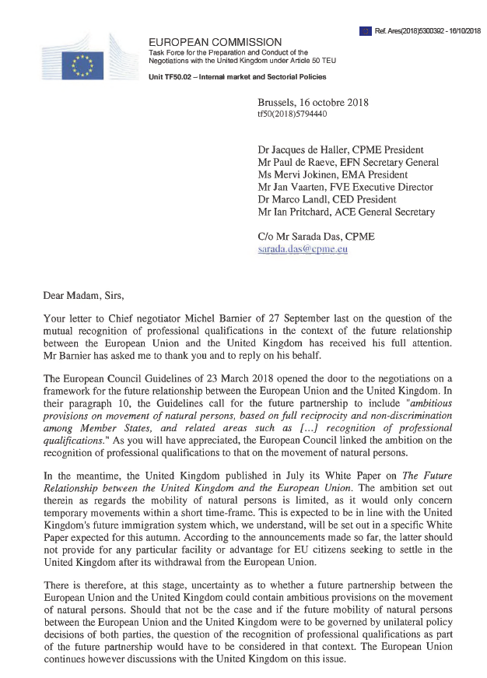
BREXIT
Notes:
On behalf of the Board, the CED signed a joint letter with other liberal professions to call for the mutual recognition of professional qualifications between the EU and UK if and when the Brexit happens
The Commission has responded and has invited the professions to a meeting with the Taskforce 50 on 22 November and which will be attended by Nina in Marco’s absence
Given the slow progress on a number of politically sensitive issues like the Irish border it will be unlikely that these details will be solved by March 2019 but we will keep you updated on the developments

Slide 8
THANK YOU FOR YOUR ATTENTION

